Slide 1


STATISTICS II
Project 2
Pavlos Polyzogopoulos (bapt1730)
Dimitris Karlis

Slide 2
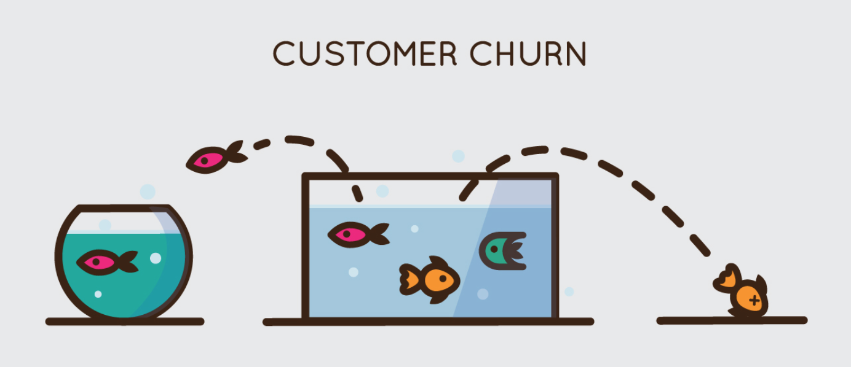
Churn
Customer churn:
Occurs when customers or subscribers stop doing business with a company or service, also known as customer attrition.
It is also referred as loss of clients or customers.
One industry in which churn rates are particularly useful is the telecommunications industry.
As most customers have multiple options from which to choose within a geographic location.
The goal is to predict customer churn

Slide 3
Logistic Regression
 |  | Actual
 |  | NO | YES
Predicted | NO | 255 | 15
 | YES | 78 | 18
Model Accuracy 86%
Sensitivity 54%
Specificity 87%

Slide 4
Decision Tree
Model Accuracy 93,8%
Sensitivity 64,5%
Specificity 98%
 |  | Actual
 |  | NO | YES
Predicted | NO | 263 | 34
 | YES | 7 | 62

Slide 5
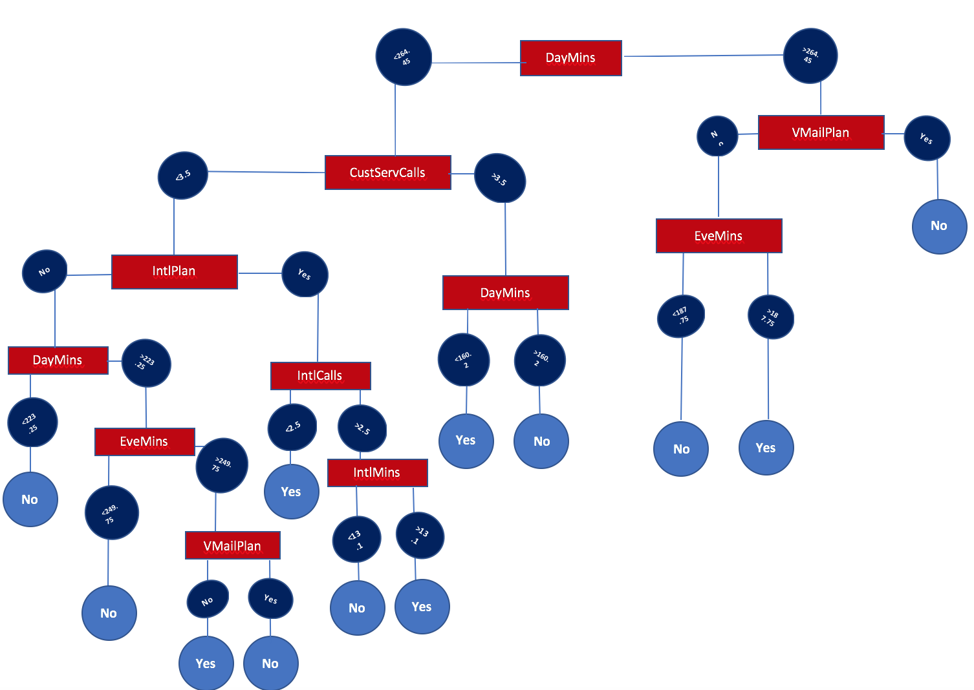
Decision Tree

Slide 6
Random Forest
 |  | Actual
 |  | NO | YES
Predicted | NO | 265 | 28
 | YES | 5 | 68
Model Accuracy 95%
Sensitivity 70%
Specificity 99%

Slide 7
Random Forest after Tuning
 |  | Actual
 |  | NO | YES
Predicted | NO | 265 | 23
 | YES | 5 | 73
Model Accuracy 95.8%
Sensitivity 76%
Specificity 99%

Slide 8
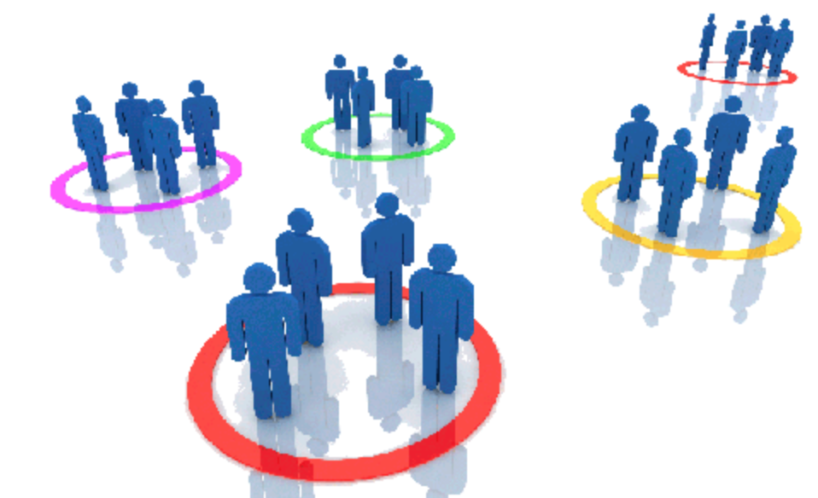
Customer Segmentation
Methodology: K-means algorithm
The goal is to cluster customers based on usage behavior.

Slide 9
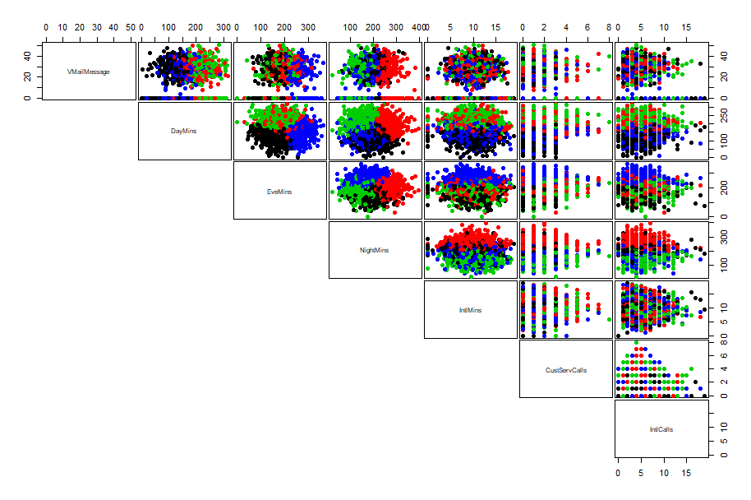
Customer Segmentation

Slide 10
Customer Segmentation
Cluster 1 : Many call minutes during day but few during the night
Cluster 2 : Many call minutes during night and day
Cluster 3 : Many call minutes during evening
Cluster 4 : Few call minutes during day and evening , average night

